Slide 1

Recurrent Neural Networks
Sampling novel sequences
deeplearning.ai

Slide 2





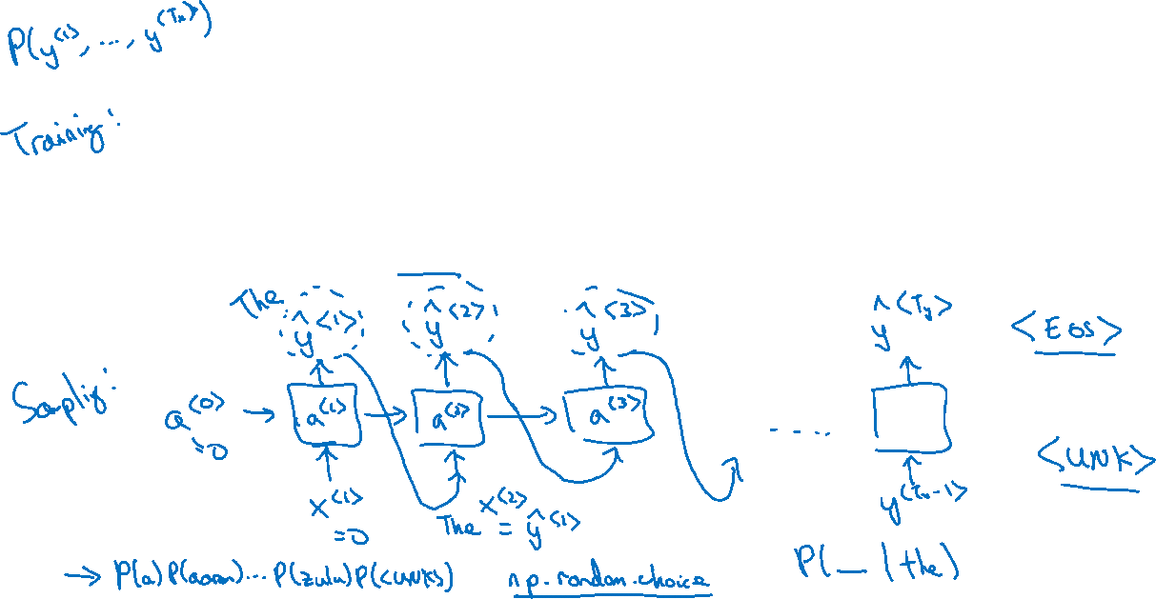









Sampling a sequence from a trained RNN
$${\hat{y}}^{<1> }$$
$${\hat{y}}^{<2> }$$
$${\hat{y}}^{<3> }$$
$${\hat{y}}^{<T_{y}> }$$
$$a^{<0>}$$
$$a^{<1>}$$
$$a^{<2>}$$
$$a^{<3>}$$
$$⋯$$
$$a^{<T_{y}>}$$
$$x^{<1>}$$
$$y^{<1>}$$
$$y^{<2>}$$
$$y^{<T_{x}−1>}$$

Slide 3





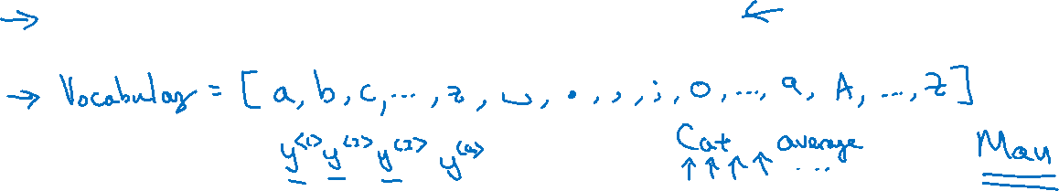






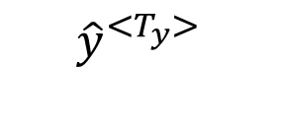


Character-level language model
Vocabulary = [a, aaron, …, zulu, <UNK>]
$${\hat{y}}^{<1> }$$
$${\hat{y}}^{<2> }$$
$${\hat{y}}^{<3> }$$
$${\hat{y}}^{<T_{y}> }$$
$$a^{<0>}$$
$$a^{<1>}$$
$$a^{<2>}$$
$$a^{<3>}$$
$$⋯$$
$$a^{<T_{y}>}$$
$$x^{<1>}$$
$${\hat{y}}^{<1> }$$
$${\hat{y}}^{<2> }$$
$${\hat{y}}^{<T_{x}−1> }$$

Slide 4
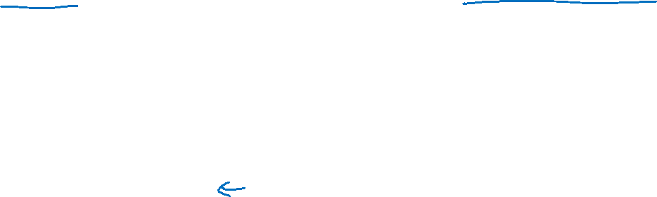
Sequence generation
News
Shakespeare
President enrique peña nieto, announced sench’s sulk former coming football langston paring.
“I was not at all surprised,” said hich langston.
“Concussion epidemic”, to be examined.
The gray football the told some and this has on the uefa icon, should money as.
The mortal moon hath her eclipse in love.
And subject of this thou art another this fold.
When besser be my love to me see sabl’s.
For whose are ruse of mine eyes heaves.

